Slide 1

IoT-Enhanced Drowsiness Detection System for IT Employees: Boosting Productivity with AI and Wearable Technology
Under the guidance of :
Mrs. P. Laxmi
Assistant Professor
Team Members:
S. Snigdha[20P61A6644]
V. Vishnu Priya[20P61A6656]
J. Valli Manasa[21P65A6603]

Slide 2
CONTENTS
ABSTRACT
PROBLEM STATEMENT
EXISTING SYSTEM
PROPOSED SYSTEM
LITERATURE REVIEW
SYSTEM ARCHITECTURE
METHODOLOGY
IMPLEMENTATION
RESULTS
STATUS OF RESEARCH PAPER
CONCLUSION

Slide 3
ABSTRACT
The Project aims to enhance IT employee productivity through a real-time drowsiness detection system, integrating Artificial Intelligence (AI) and the Internet of Things (IoT). Using a basic webcam, the system monitors the individual's eyes and mouth for drowsiness indicators like yawning and closed eyes, triggering an alarm for alerting. A wristband is employed to vibrate and wake up the person. Machine learning and image processing focus on the facial area, utilizing a Facial Landmark Detector from the Dlib Library. The primary goal is to prevent productivity loss from drowsiness and work fatigue in online employees. The process involves detecting the face, locating eyes and mouth, and measuring the eye-mouth distance. Repeated instances of closed eyes and open mouth activate an alerting buzz and vibrating wristband. The hardware-software combination includes RF wireless technology for laptop-wristband communication, emphasizing IoT integration in the project.
Keywords: Drowsiness detection, Productivity enhancement, IoT integration, RF wireless technology, Real-time monitoring, Artificial Intelligence (AI), Image processing, Internet of Things (IoT), Jetson Nano Board.

Slide 4
PROBLEM STATEMENT
Drowsiness is a serious issue affecting IT employees, causing problems like reduced productivity, and health issues. Many IT workers face long hours and tight deadlines, which can make them feel tired and unable to concentrate. This not only slows down projects but also puts their health at risk. Companies need to find solutions to help their employees get enough rest. This could include offering flexible work hours, teaching good sleep habits, or using technology to monitor tiredness levels and remind people to take breaks might help too. Ultimately, creating a workplace where people can balance their work and personal life is key to keeping IT employees alert, happy, and healthy.

Slide 5
EXISTING SYSTEMS
1) Eye-Tracking Systems:
Monitors eye movements, such as blink rate and gaze direction.
Drowsiness is often associated with slower eye movements and decreased blink frequency.
Drawbacks:
Expensive Hardware: High-quality eye-tracking hardware can be costly, making widespread implementation challenging.
Calibration: Individual calibration is necessary for accurate detection, and this process can be time-consuming.
Lighting Conditions: Performance may be affected in low-light environments.
Limited Indicator: Blink frequency alone may not be a sufficient indicator of drowsiness, and false positives/negatives can occur.

Slide 6
2) Electroencephalogram (EEG) based Systems:
Measures electrical activity in the brain to detect patterns associated with alertness and drowsiness.
Drawbacks:
Invasive: Requires attaching electrodes to the scalp, which can be uncomfortable for users.
External Factors: Signal quality can be influenced by external factors like muscle movements and ambient electrical noise.
Interpretation Challenges: Interpreting EEG patterns accurately for drowsiness may vary among individuals.
3) Heart Rate Variability (HRV) Monitoring:
Analyzes variations in the time intervals between heartbeats, which can indicate fatigue.
Drawbacks:
Continuous Monitoring: Requires sensors for continuous heart rate monitoring, which may not be practical in all situations.
Individual Variability: HRV response to fatigue can vary among individuals.
External Factors: Physical activity and other non-drowsiness-related factors can impact HRV.

Slide 7
4) Computer Vision-based Systems:
Uses facial feature analysis and expressions to detect signs of drowsiness.
Drawbacks:
Sensitivity to Conditions: Performance is sensitive to lighting conditions and camera quality.
Non-specific Expressions: Facial expressions can be influenced by factors other than drowsiness, leading to false positives.
Variability: Accuracy may vary based on the diversity of facial features among users.
5) Machine Learning Models:
Utilizes machine learning algorithms trained on features like eye movement, facial expressions, or physiological signals.
Drawbacks:
Overfitting: There is a risk of overfitting, especially when training on limited datasets.
Data Requirements: Requires extensive and diverse training data to generalize well across different individuals and conditions.
Interpretability: Complex models may lack interpretability, making it challenging to understand the decision-making process.

Slide 8
PROPOSED SYSTEM
The project aims to improve the productivity of IT employees by detecting drowsiness in real-time integrating Artificial Intelligence (AI) and the Internet of Things (IoT).
It Utilizes a basic webcam positioned to directly face the individual. The webcam is programmed with code to monitor the eyes and mouth of the user.
The system employs image processing and machine learning techniques to detect symptoms of drowsiness. Symptoms include yawning and closed eyes
If the eyes are found closed and the mouth is found open for a specific time, the event is recorded. A predefined threshold (e.g., occurring more than 2 times) triggers the alerting mechanisms.
If the specified conditions persist, an alerting buzz is sent to the employee. Simultaneously, the vibrating wristband is activated to wake up the person.
The system involves both hardware and software components. RF (Radio Frequency) wireless technology is used for communication between the laptop and the wristband.

Slide 9
OBJECTIVES :
Create a pioneering solution that addresses drowsiness issues among IT professionals, thereby enhancing their overall productivity and work experience
Integrate wearable devices, such as wristbands, to provide immediate feedback and alerts in response to detected drowsiness.
Focus on monitoring employees working online to address productivity issues related to drowsiness and work fatigue.

Slide 10
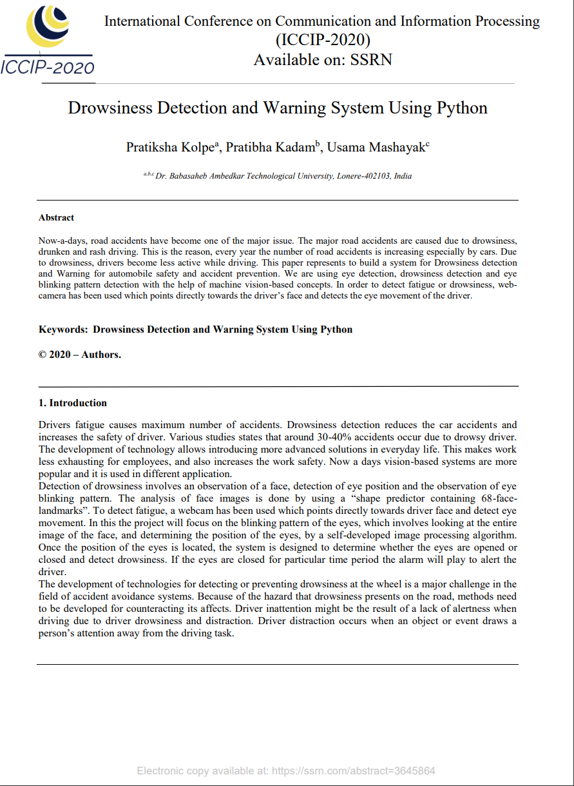
LITERATURE REVIEW
Research Paper-1
Drowsiness Detection and Warning System Using Python
Authors: Pratiksha K , Pratibha K , Usama Mashayak
The paper focuses on addressing the critical issue of road accidents caused by factors like drowsiness, drunken driving, and reckless behavior.
The proposed solution involves developing a system for Drowsiness Detection and Warning to enhance automobile safety and prevent accidents.
The system employs machine vision-based techniques including eye detection, drowsiness detection, and eye blinking pattern analysis.
A webcam is utilized to monitor the driver's face and track their eye movements, primarily aiming to detect signs of fatigue or drowsiness.

Slide 11
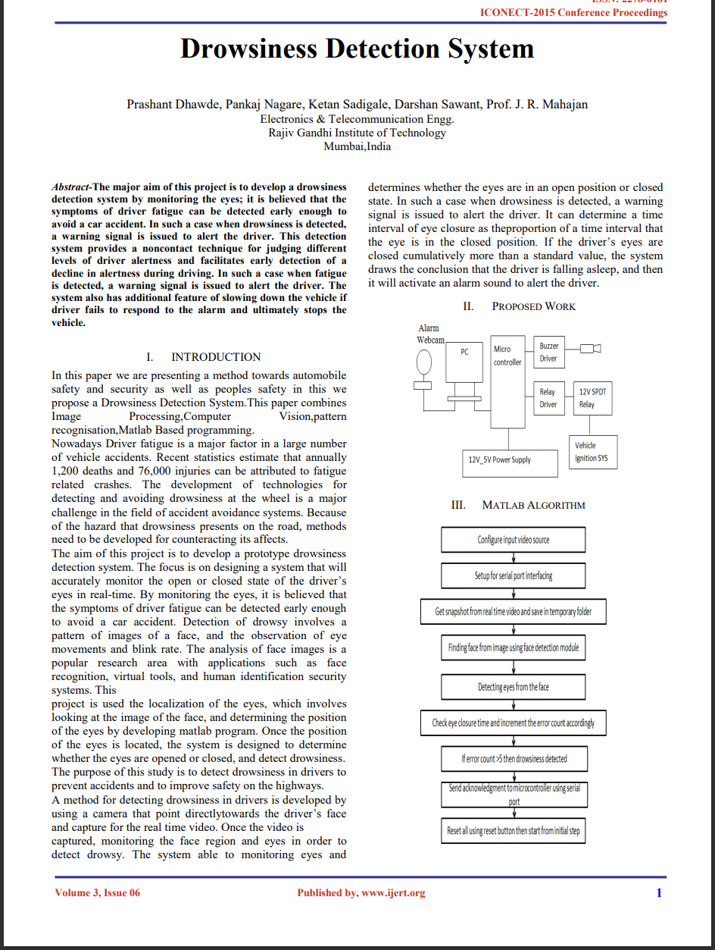
Research Paper-2
Drowsiness Detection System
Authors: Prashant D, Pankaj, Ketan, Darshan, Mahajan
The paper presents a Drowsiness Detection System for enhancing automobile safety and preventing accidents.
The system utilizes Image Processing, Computer Vision, pattern recognition, and Matlab-based programming.
Driver fatigue is a significant contributor to accidents, and the paper aims to develop a prototype system that monitors the driver's eyes in real-time to detect drowsiness symptoms early and prevent accidents.
The system analyzes patterns of facial images, eye movements, and blink rates to identify drowsiness. It uses a camera focused on the driver's face to capture real-time video and issues warnings if drowsiness is detected.

Slide 12
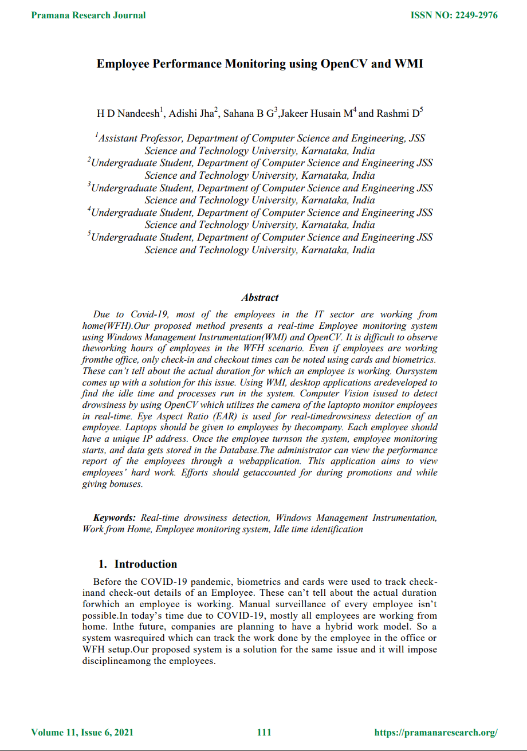
Research Paper-3
Employee Performance Monitoring using OpenCV and WMI
Authors: H D Nandeesh, Adishi, Sahana, Jakeer, Rashmi
The system employs unique IP addresses to identify employees and utilizes image processing, specifically OpenCV, to monitor them in real-time.
Drowsiness detection is achieved through Eye Aspect Ratio (EAR), measured using the laptop's camera. When the EAR value falls below a predefined threshold for a set number of frames, drowsiness is recorded in the database.
Beyond drowsiness detection, the system calculates idle time and identifies restricted processes running on employees' systems.
These functions operate discreetly in the background without interfering with other applications. Idle time is measured using Windows Management Instrumentation (WMI), and instances of restricted processes trigger alerts.
An administrator's web application provides access to employee reports, aiding audits and promoting transparency. The proposed system aims to eliminate unproductive activities, fostering a more productive work environment. These reports can be valuable for performance evaluations and bonuses, ensuring fair assessments for all employees.

Slide 13
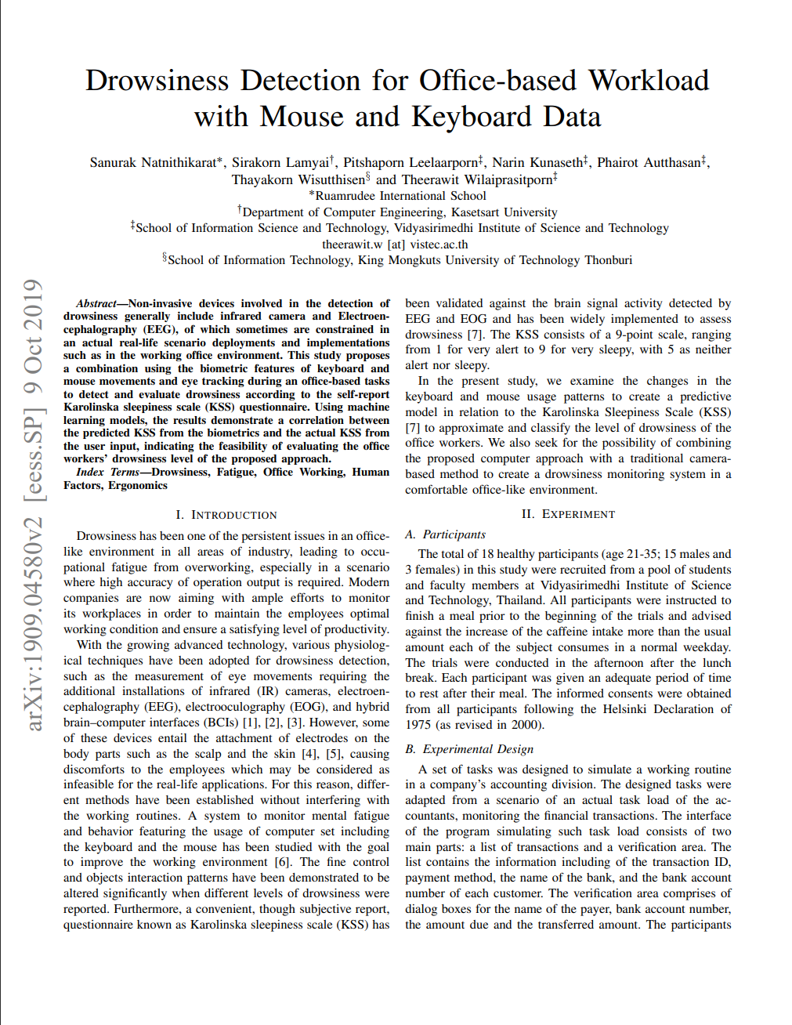
Research Paper-4
Drowsiness Detection for Office-based Workload with Mouse and Keyboard Data
Authors: Sanurak, Sirakorn, Pitshaporn, Narin, Phairot, Thayakon, Theerawai
The Paper discusses a study that aims to detect drowsiness in office environments using a new approach. While existing methods like infrared cameras and EEG[Electro Encephalogram] have limitations, the study proposes a combination of biometric features: keyboard and mouse movements, and eye tracking.
The goal is to accurately assess drowsiness based on these interactions and correlate them with self-reported drowsiness scores from the Karolinska Sleepiness Scale (KSS) questionnaire. Machine learning models are trained to predict drowsiness levels using the combined biometric data.
Results indicate a correlation between predicted and actual drowsiness levels, suggesting that this approach could effectively evaluate office workers' drowsiness levels. This could have practical implications for improving productivity and safety in office settings.

Slide 14
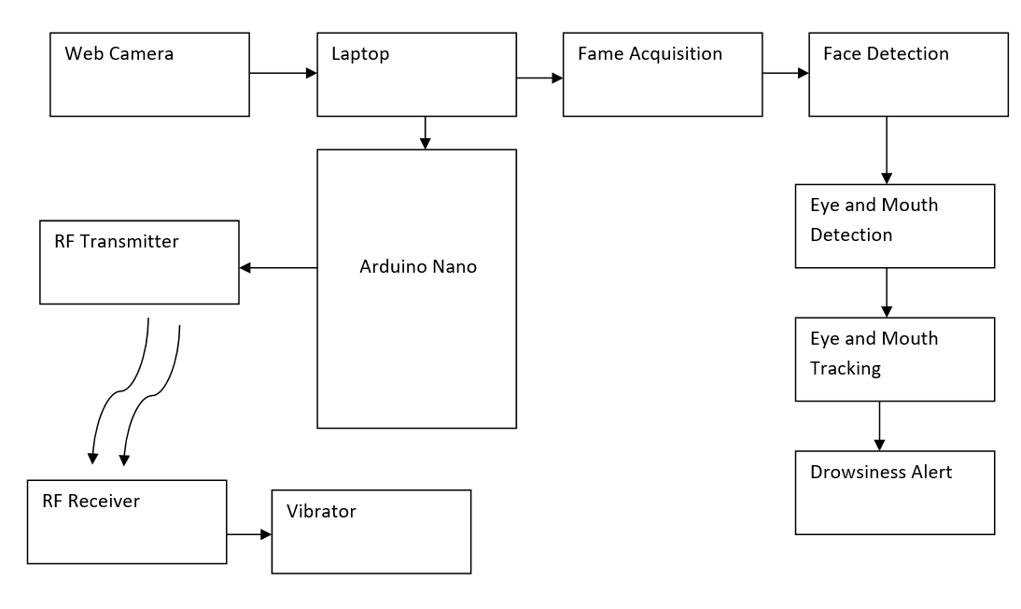
SYSTEM ARCHITECTURE

Slide 15
METHODOLOGY
The methodologies used in this code are as follows:
a) Eye Aspect Ratio (EAR):
Calculates the ratio of distances between certain landmarks on the eyes to detect blinking.
Utilizes the Euclidean distance to measure the distance between key points on the eyes.
b)Final Eye Aspect Ratio (final_ear):
Calculates the average EAR for both eyes.
Combines the EAR calculation for the left and right eyes to get a more robust measure of eye openness.
c) Lip Distance:
Measures the vertical distance between the upper and lower lips to detect yawning.
Utilizes the Euclidean distance to measure the distance between specific lip landmarks.
d)Face Detection (Haar Cascade Classifier):
Utilizes a pre-trained cascade classifier to detect faces in the video frames
Employs the Viola-Jones object detection framework to detect faces efficiently.
Provides bounding boxes around detected faces.

Slide 16
e)Facial Landmark Detection (dlib's shape predictor):
Detects facial landmarks such as eyes, nose, mouth, etc.
Uses the dlib library's pre-trained shape predictor model to locate these landmarks.
Provides precise coordinates for various facial features.
f) Convex Hull:
Identifies the convex hull of the eyes to visualize and analyze eye regions.
Utilizes the Convex Hull algorithm to find the smallest convex polygon that encloses the eye landmarks.
g)Alarm System:
Triggers an alarm (beep sound) when drowsiness or yawning is detected.
Utilizes the Pygame library to play audio files for the alarm sound.
Implements multithreading for continuous monitoring while the alarm is active.
Uses the espeak command-line tool to generate spoken alerts for additional auditory feedback.
h)Arduino Integration:
Sends signals to an Arduino board connected via serial communication to trigger external actions (such as turning on a fan) based on detected events.
Uses the PySerial library to establish communication with the Arduino board and send data over the serial port.

Slide 17
IMPLEMENTATION
Step-1 : Setup Hardware:
Acquire necessary hardware components including a webcam for video input and an Arduino board for interfacing with external devices.
Step-2: Install Dependencies:
Install required libraries and dependencies including OpenCV, dlib, imutils, Pygame, and PySerial.
Step-3: Define Constants and Thresholds:
Set thresholds for eye aspect ratio (EAR), consecutive frames for drowsiness detection, and yawning distance threshold.
Step-4: Load Models:
Load the pre-trained Haar Cascade classifier for face detection and dlib's shape predictor model for facial landmark detection.
Step-5:Initialize Video Stream:
Start the video stream from the webcam using OpenCV or imutils.

Slide 18
Step-6: Main Loop:
Continuously capture frames from the video stream.
Step-7:Face Detection:
Use the Haar Cascade classifier to detect faces in each frame.
Draw bounding boxes around detected faces.
Step-8: Facial Landmark Detection:
For each detected face, use the shape predictor to locate facial landmarks such as eyes and lips.
Calculate the eye aspect ratio (EAR) and lip distance for drowsiness and yawning detection, respectively.
Step-9: Eye Blink Detection:
If the calculated EAR falls below the threshold for a certain number of consecutive frames, trigger a drowsiness alert.
Play an alarm sound and send a signal to the Arduino board to activate external alerts (e.g., LED lights or a buzzer).
Step-10:Yawn Detection:
If the lip distance exceeds the predefined threshold, trigger a yawn alert.
Play an alarm sound and send a signal to the Arduino board for external alerts.

Slide 19
Step- 11: Multithreading for Alerts:
Utilize multithreading to handle concurrent tasks such as playing audio alerts and sending signals to the Arduino board.
Step-12: Terminate Program:
Allow the user to terminate the program by pressing a designated key (e.g., 'q’).
Step-13:Cleanup:
Release video stream resources and close any open windows before terminating the program.
Step-14: Arduino Integration:
Establish serial communication with the Arduino board and send appropriate signals based on detected events (e.g., drowsiness or yawning).
Implement Arduino code to receive signals and trigger external alerts or actions.
Step-15: Testing and Optimization:
Test the system with different scenarios and adjust thresholds or parameters for optimal performance.
Optimize the code for efficiency and reliability, considering factors such as frame rate and processing speed.

Slide 20
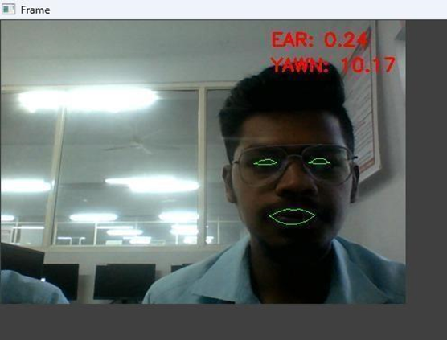
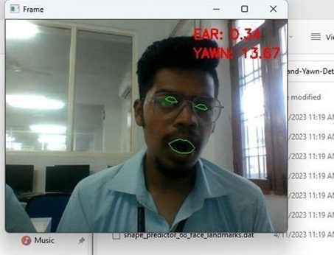
RESULTS
Fig-1: Prototype Interface
Fig-2: Drowsiness detected

Slide 21
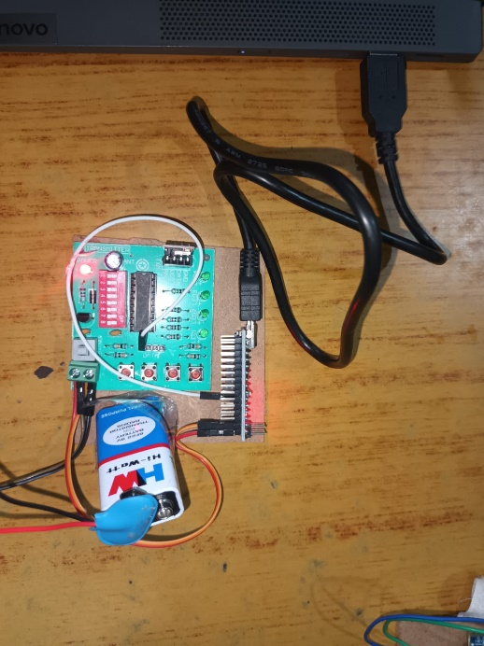
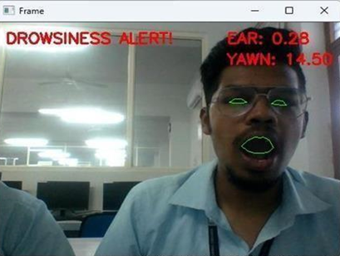
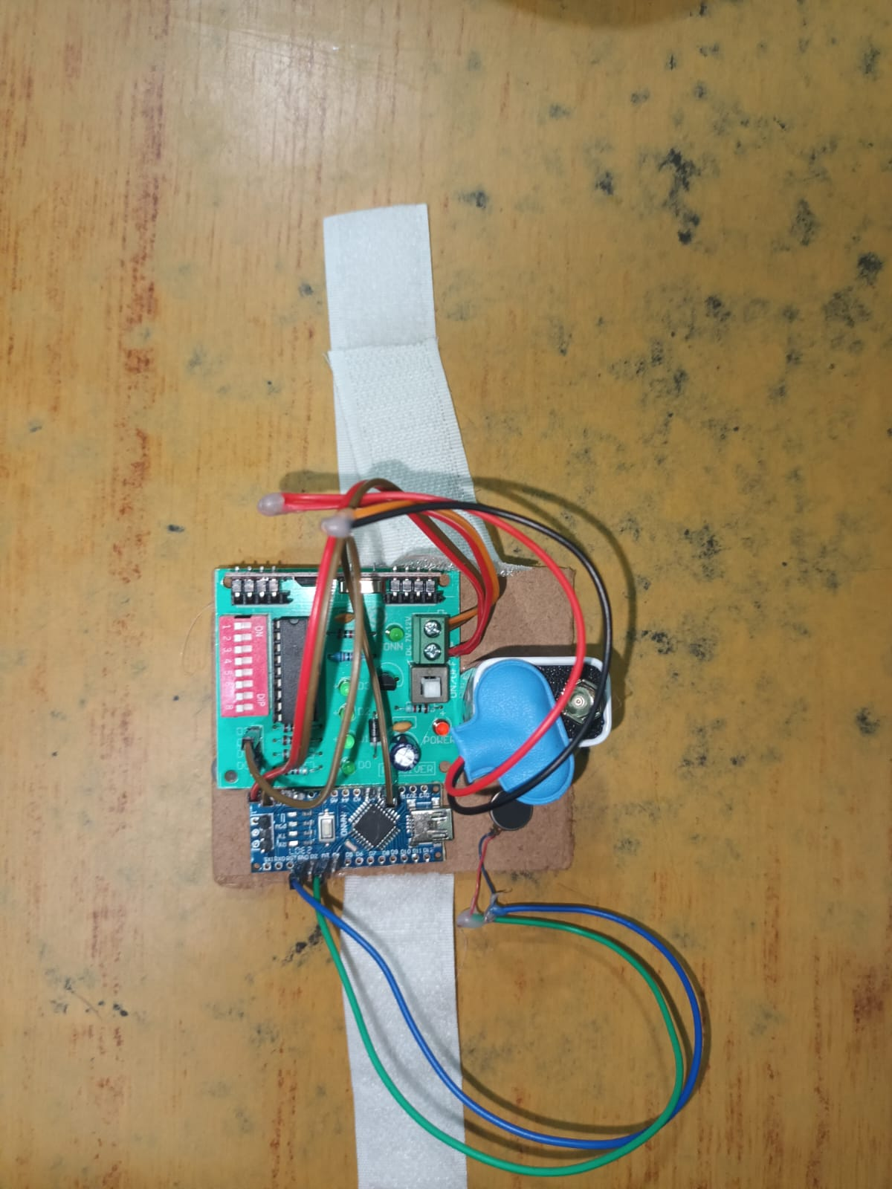
Fig-3: Drowsiness alert
Fig-4: RF transmitter
Fig-5: Wrist band with RF receiver and vibrator

Slide 22
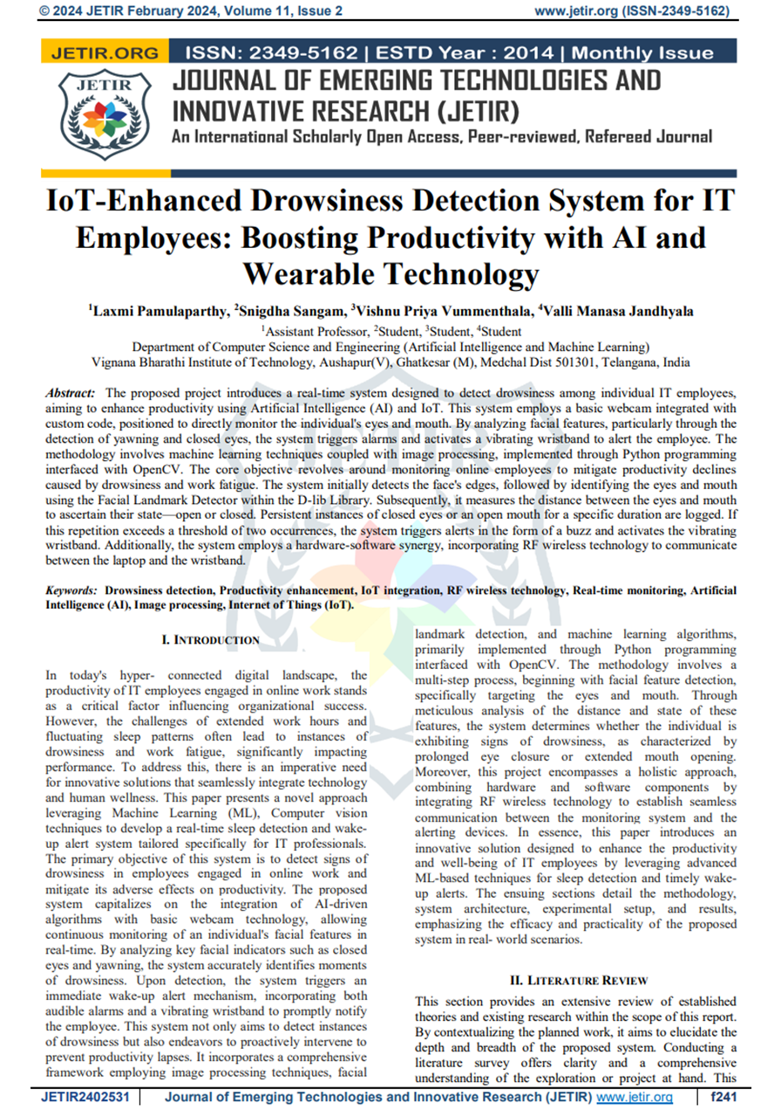
PUBLISHED PAPER

Slide 23
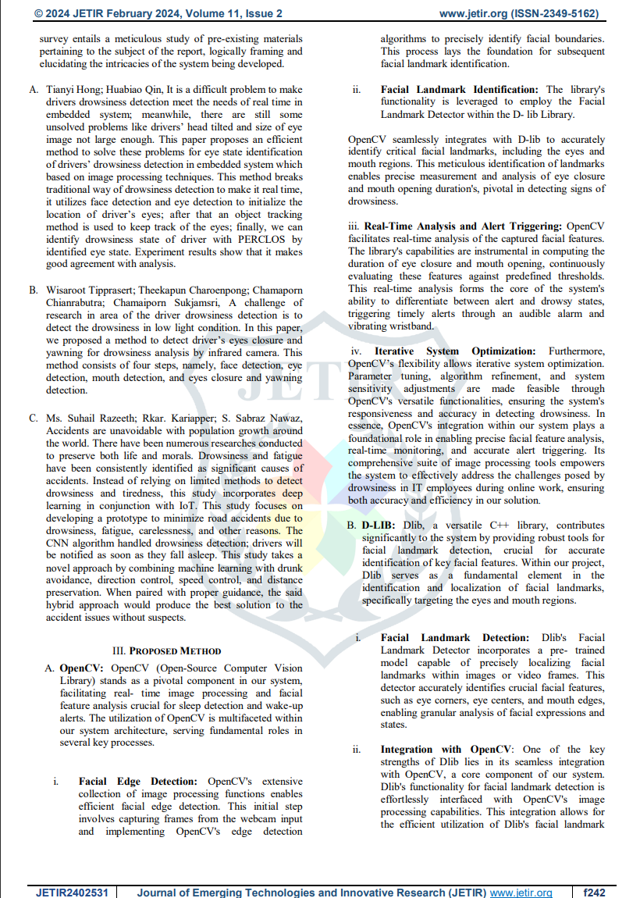

Slide 24
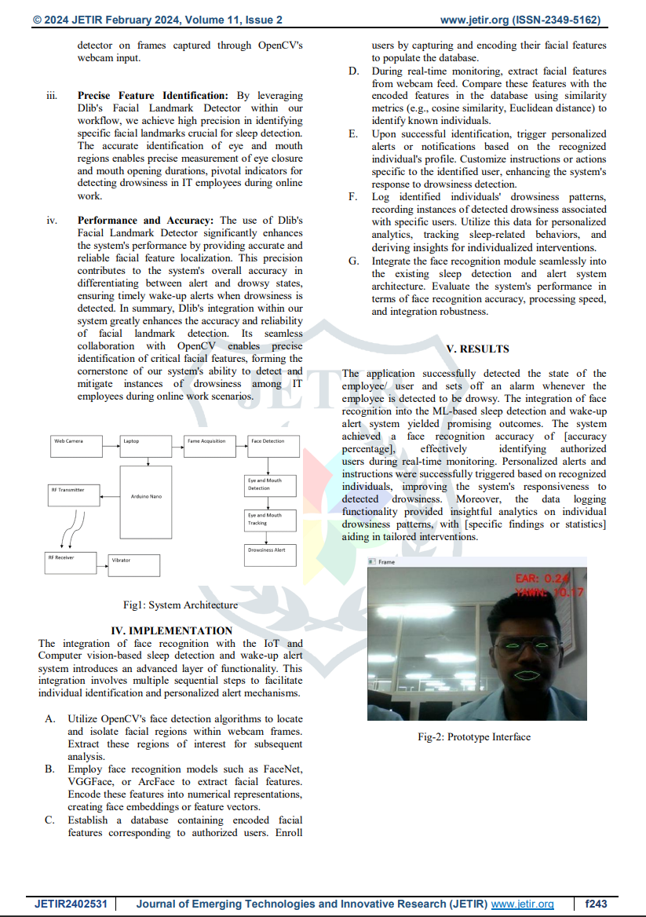

Slide 25
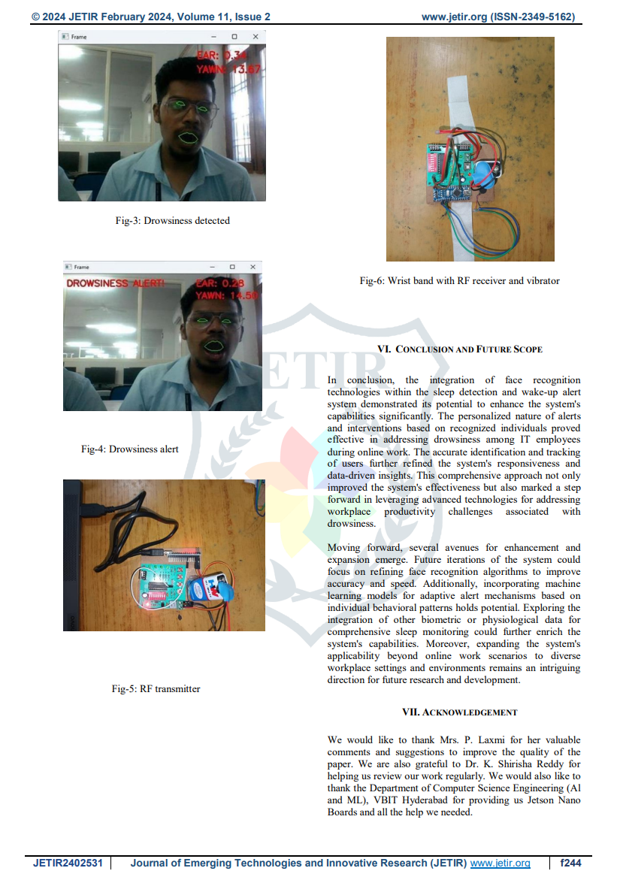

Slide 26
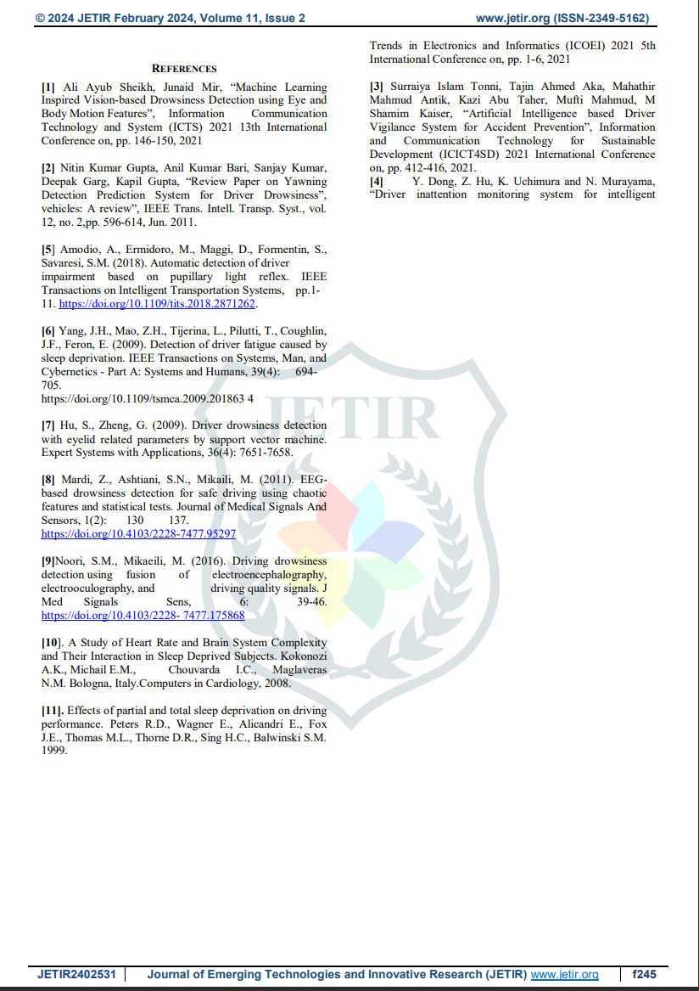

Slide 27
CONCLUSION
In conclusion, the developed project offers a comprehensive solution for real-time drowsiness and yawning detection using facial landmarks and features. By leveraging algorithms such as eye aspect ratio (EAR) calculation and lip distance measurement, coupled with face detection and facial landmark detection techniques, the system effectively monitors a person's behavior during work. The integration of an Arduino board allows for seamless interaction with external devices, enabling the system to trigger alerts or actions in response to detected events.
Overall, this project demonstrates the potential of combining computer vision, machine learning, and embedded systems to address real-world challenges, particularly in the realm of safety-critical applications. By leveraging advancements in technology, such as OpenCV, dlib, and Arduino, the developed solution showcases the power of interdisciplinary approaches in creating innovative solutions for enhancing human well-being and safety.

